Slide 1







React JS: Context API & React Hooks
Himanshu
Proudly recognized by

Slide 2
Context API
useRef
useMemo
useCallback
Custom Hooks
Form
API & fetch, axios
Promises
Agenda

Slide 3
Context API

Slide 4
Why Context API?
React normally shares data via props — but this becomes painful when the same data is needed in many nested components.
This problem is called "Prop Drilling" (passing props through multiple levels unnecessarily).
The Context API lets us share data without prop drilling, by providing a global “store” accessible from any component.
Key Terms:
Provider: Supplies the data (state or function).
Consumer: Reads or uses that data.
Context Object: Created with React.createContext().

Slide 5
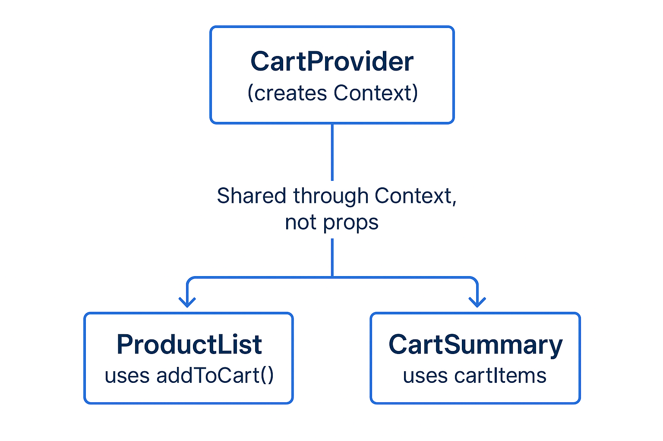
Context API

Slide 6
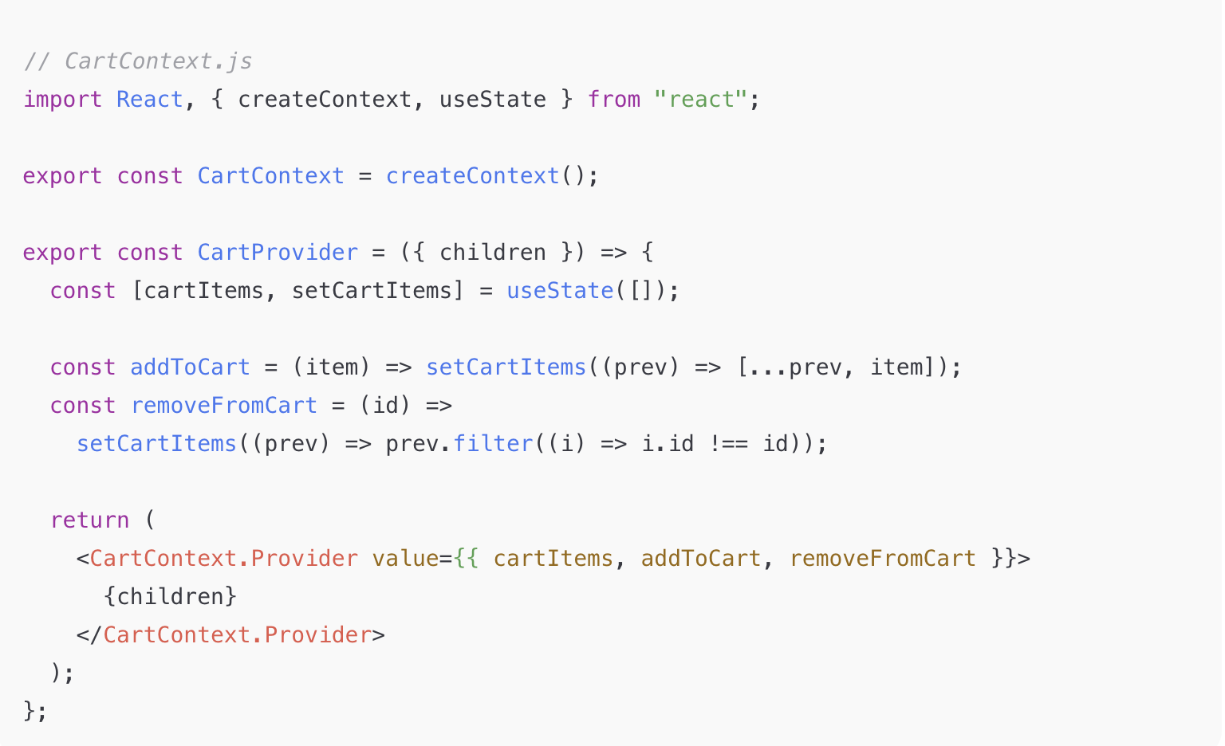
Example Code: Cart Context
Notes:
// CartContext.js
import React, { createContext, useState } from "react";
export const CartContext = createContext();
export const CartProvider = ({ children }) => {
const [cartItems, setCartItems] = useState([]);
const addToCart = (item) => setCartItems((prev) => [...prev, item]);
const removeFromCart = (id) =>
setCartItems((prev) => prev.filter((i) => i.id !== id));
return (
<CartContext.Provider value={{ cartItems, addToCart, removeFromCart }}>
{children}
</CartContext.Provider>
);
};

Slide 7
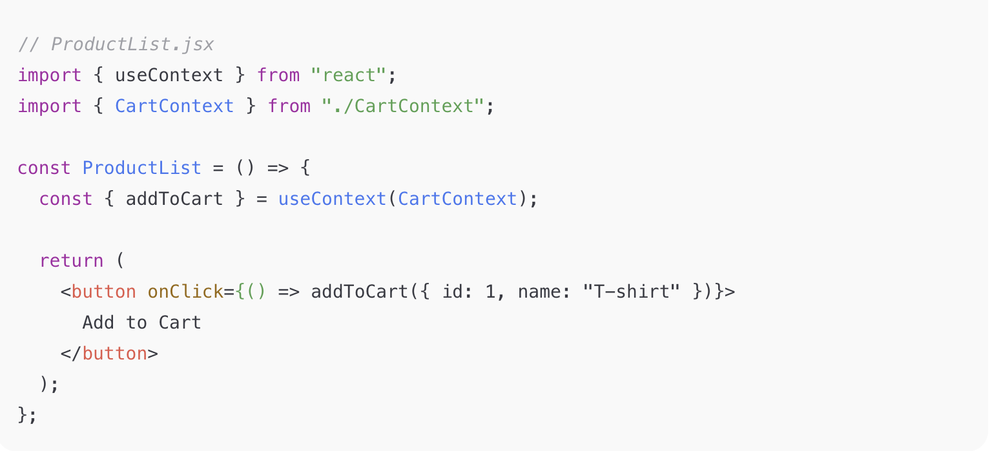
Example Code: Cart Context
Notes:
“Here, CartProvider wraps the app and shares both data (cartItems) and behavior (addToCart, removeFromCart).
useContext helps us consume that data anywhere in the component tree.” // ProductList.jsx
import { useContext } from "react";
import { CartContext } from "./CartContext";
const ProductList = () => {
const { addToCart } = useContext(CartContext);
return (
<button onClick={() => addToCart({ id: 1, name: "T-shirt" })}>
Add to Cart
</button>
);
};

Slide 8
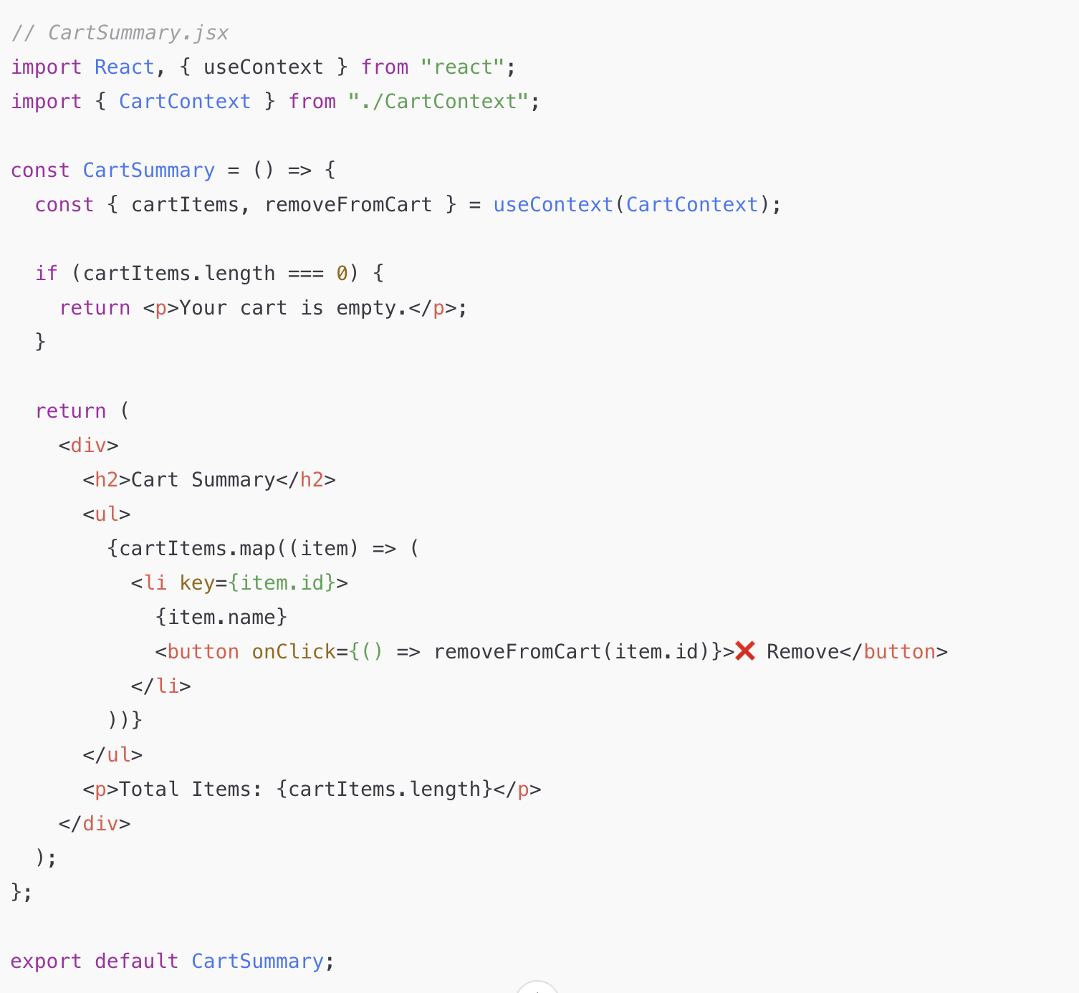
Example Code: Cart Context
Notes:
// CartSummary.jsx
import React, { useContext } from "react";
import { CartContext } from "./CartContext";
const CartSummary = () => {
const { cartItems, removeFromCart } = useContext(CartContext);
if (cartItems.length === 0) {
return <p>Your cart is empty.</p>;
}
return (
<div>
<h2>Cart Summary</h2>
<ul>
{cartItems.map((item) => (
<li key={item.id}>
{item.name}
<button onClick={() => removeFromCart(item.id)}>❌ Remove</button>
</li>
))}
</ul>
<p>Total Items: {cartItems.length}</p>
</div>
);
};
export default CartSummary;

Slide 9
Pros & Cons of Context API
✅ Pros:
Eliminates prop drilling
Built-in React feature (no external library)
❌ Cons:
Performance issues with frequent updates
Not ideal for complex state management (Consider Redux for that)
Notes:
Real-World Use Cases
Cover the common ones:
Theme switching (light/dark mode)
Authentication + User data (current user)
Language/i18n
Cart / Wishlist (simple e-commerce)
Global alerts/toasts
When NOT to Use Context
Important for design thinking:
NOT for every state
NOT for frequently updating values (e.g., mouse position)
NOT for high-frequency UI updates — prefer external stores (Redux, Zustand, Jotai)

Slide 10
What is useRef?
The useRef hook allows you to persist value between renders
It can be used to store values that when updated doesn’t cause re-render.
The useRef is used to directly access a dom element
useRef() only returns one item. It returns an Object called current.
Common use cases:
Managing focus, text selection, or media playback.
Storing previous values without causing re-renders.
Creating timers and intervals.
Think of useRef as a secret notepad that React doesn’t watch — you can write on it without triggering a re-render.

Slide 11
What is useRef?
Explanation:
useRef() creates a reference object { current: null }
ref={inputRef} connects the <input> element to that ref
When the button is clicked, inputRef.current gives direct DOM access

Slide 12
What is useMemo?
useMemo is a React Hook that memorizes (remembers) the result of a computation between renders. It only re-computes the value when one of its dependencies changes.
Common use cases:
Optimizing slow computations.
Reducing unnecessary re-renders.
Improving performance in large lists.
Syntax:-
const memoizedValue = useMemo(() => computeExpensiveValue(a, b), [a, b]);
Notes:
React compares dependencies using Object.is(), and:
import React, { useState, useMemo } from "react";
const ExpensiveCalculation = ({ num }) => {
const compute = (n) => {
console.log("Calculating...");
for (let i = 0; i < 1000000000; i++) {} // heavy loop
return n * 2;
};
const result = useMemo(() => compute(num), [num]);
return <p>Result: {result}</p>;
};
export default function App() {
const [num, setNum] = useState(5);
const [theme, setTheme] = useState("light");
return (
<div>
<ExpensiveCalculation num={num} />
<button onClick={() => setTheme(theme === "light" ? "dark" : "light")}>
Toggle Theme
</button>
</div>
);
}
import React, { useState, useMemo } from "react";
const users = [
{ name: "Alice", role: "admin" },
{ name: "Bob", role: "user" },
{ name: "Charlie", role: "admin" },
];
export default function UserList() {
const [filter, setFilter] = useState("all");
const filteredUsers = useMemo(() => {
console.log("Filtering users...");
return filter === "all"
? users
: users.filter((user) => user.role === filter);
}, [filter]);
return (
<div>
<select onChange={(e) => setFilter(e.target.value)}>
<option value="all">All</option>
<option value="admin">Admins</option>
<option value="user">Users</option>
</select>
<ul>
{filteredUsers.map((u) => (
<li key={u.name}>{u.name}</li>
))}
</ul>
</div>
);
}

Slide 13
What is useCallback?
useCallback is a React Hook that memoizes a function — it returns the same function instance across renders, unless one of its dependencies changes.
Syntax:- const memoizedFn = useCallback(() => doSomething(a, b), [a, b]);
Why It’s Needed
React components often pass functions to children. If a parent re-renders, new function references are created — even if the function’s logic hasn’t changed.
This can cause:
Unnecessary re-renders of memoized child components (React.memo)
Performance degradation in large lists or UIs
Use useCallback when:
Passing functions to memoized child components (React.memo)
Functions are dependencies inside useEffect, useMemo, etc.
Notes:
useCallback with useEffect
useCallback + React.memo combo React.memo stops re-renders when props don’t change. useCallback ensures function props don’t change.
import React, { useState, useCallback } from "react";
const Child = React.memo(({ onClick }) => {
console.log("Child rendered");
return <button onClick={onClick}>Increment</button>;
});
export default function Parent() {
const [count, setCount] = useState(0);
const [theme, setTheme] = useState("light");
const increment = useCallback(() => setCount((c) => c + 1), []);
return (
<div>
<h3>Count: {count}</h3>
<Child onClick={increment} />
<button onClick={() => setTheme(theme === "light" ? "dark" : "light")}>
Toggle Theme
</button>
</div>
);
}
import React, { useState, useCallback } from "react";
import { useFetch } from "./useFetch"; // from earlier section
const SearchBar = React.memo(({ onSearch }) => {
console.log("SearchBar rendered");
return (
<input
placeholder="Search users..."
onChange={(e) => onSearch(e.target.value)}
/>
);
});
export default function UserSearch() {
const [query, setQuery] = useState("");
const { data, loading } = useFetch(
`https://jsonplaceholder.typicode.com/users?name_like=${query}`
);
const handleSearch = useCallback((value) => setQuery(value), []);
return (
<div>
<SearchBar onSearch={handleSearch} />
{loading ? <p>Loading...</p> : <pre>{JSON.stringify(data, null, 2)}</pre>}
</div>
);
}

Slide 14
What are Custom Hooks?
React comes with several built-in Hooks like useState, useContext, and useEffect. Sometimes, you’ll wish that there was a Hook for some more specific purpose: for example, to fetch data, to keep track of whether the user is online, or to connect to a chat room.
Custom Hooks are JavaScript functions that use React Hooks inside them.
They help you extract and reuse stateful logic (not UI).
Naming convention: always start with "use" (e.g., useForm, useFetch).

Slide 15
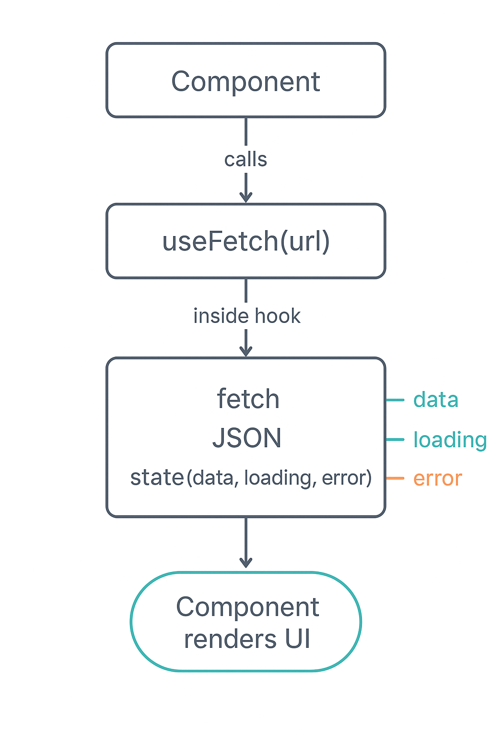
What are Custom Hooks?

Slide 16
Usage of Custom Hooks
Code…

Slide 17
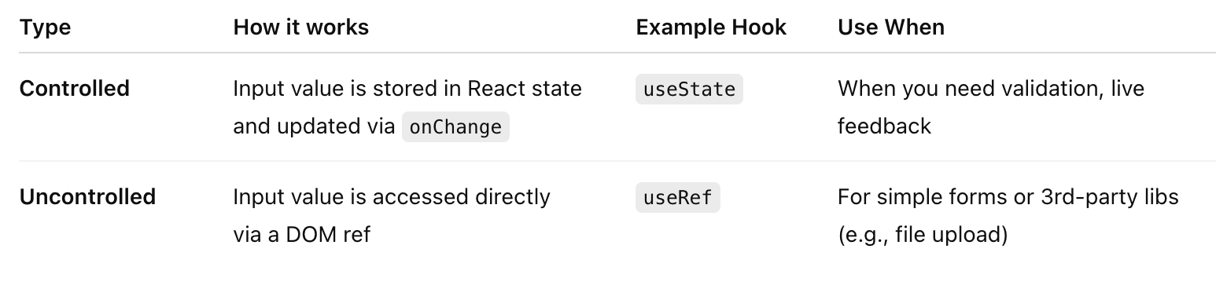
React Forms
Forms in React let users interact with data — but React doesn’t let the browser manage form state directly.
Instead, React takes control via state — so your inputs always reflect your app’s data.

Slide 18
React Forms
Controlled:- Every keystroke updates React state → React re-renders → input shows the latest value.
Un-controlled:- React doesn’t manage the input value — it reads it directly from the DOM when needed.
Code…

Slide 19
Fetch API
The Fetch API provides a JavaScript interface for making HTTP requests and processing the responses.
Fetch is the modern replacement for XMLHttpRequest: unlike XMLHttpRequest, which uses callbacks, Fetch is promise-based and is integrated with features of the modern web such as service workers and Cross-Origin Resource Sharing (CORS).
The fetch() function returns a Promise which is fulfilled with a Response object representing the server's response. You can then check the request status and extract the body of the response in various formats, including text and JSON, by calling the appropriate method on the response.
Syntax:-await fetch(url)
By default, fetch() makes a GET request, but you can use the method option to use a different request method:
Notes:
fetch("api/users")
.then(res => {
console.log(res.ok); // true or false
console.log(res.status); // 404, 500 etc
});

Slide 20
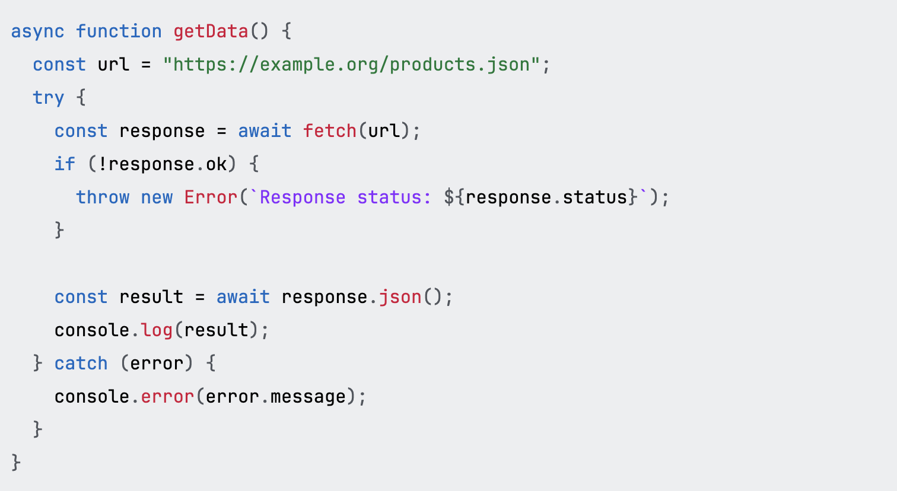
Fetch API Example - GET
The fetch() function will reject the promise on some errors, but not if the server responds with an error status like 404: so we also check the response status and throw if it is not OK.

Slide 21
Fetch API Example - POST
const response = await fetch("https://example.org/post", {
method: "POST",
body: JSON.stringify({ username: "example" }),
// …
});
Setting request headers:- const response = await fetch("https://example.org/post", {
method: "POST",
headers: {
"Content-Type": "application/json",
},
body: JSON.stringify({ username: "example" }),
// …
});

Slide 22
Making cross-origin requests
Whether a request can be made cross-origin or not is determined by the value of the RequestInit.mode option. This may take one of three values: cors, same-origin, or no-cors.
For fetch requests the default value of mode is cors, meaning that if the request is cross-origin then it will use the Cross-Origin Resource Sharing (CORS) mechanism. This means that:
if the request is a simple request, then the request will always be sent, but the server must respond with the correct Access-Control-Allow-Origin header or the browser will not share the response with the caller.
if the request is not a simple request, then the browser will send a preflighted request to check that the server understands CORS and allows the request, and the real request will not be sent unless the server responds to the preflighted request with the appropriate CORS headers.
Setting mode to same-origin disallows cross-origin requests completely.
Setting mode to no-cors disables CORS for cross-origin requests. This restricts the headers that may be set, and restricts methods to GET, HEAD, and POST. The response is opaque, meaning that its headers and body are not available to JavaScript. Most of the time a website should not use no-cors: the main application of it is for certain service worker use cases.

Slide 23
Introduction to Axios
A popular HTTP client library for JavaScript
Works in browser & Node.js
Used to make: GET, POST, PUT, DELETE requests. Handle JSON easily.
Why Use Axios?
Automatic JSON conversion
Built-in timeout support
Request & Response interceptors
Better error handling
Supports canceling requests
Works well with React

Slide 24
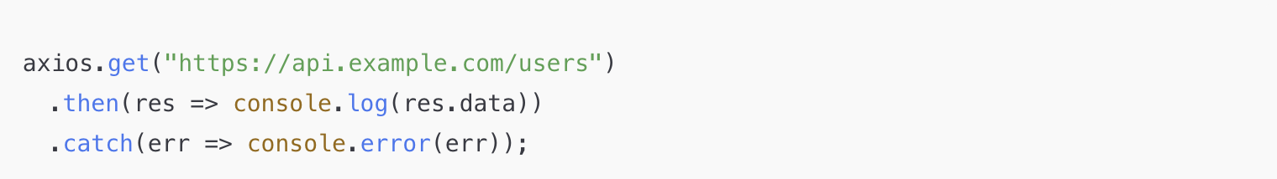
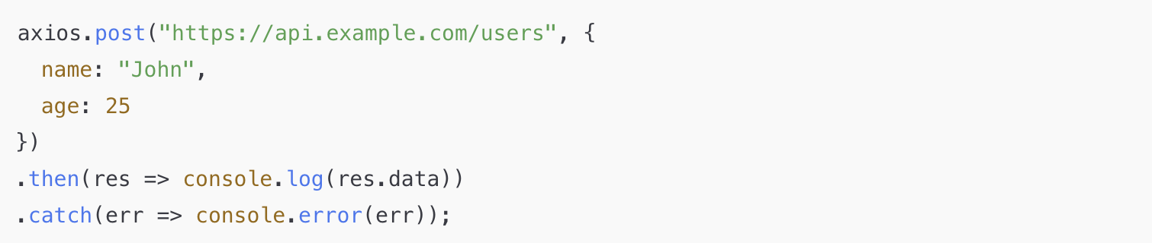
Axios

Slide 25
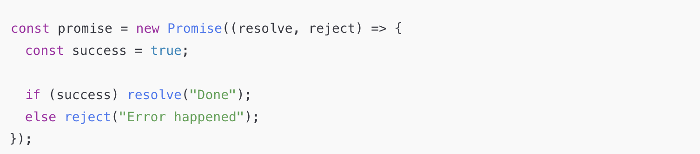
What is a Promise?
A Promise represents a value that will be available now, later, or never.
It helps handle async operations without callback hell.
THREE states:
pending
fulfilled
rejected

Slide 26
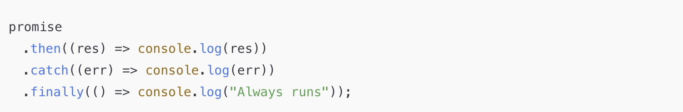
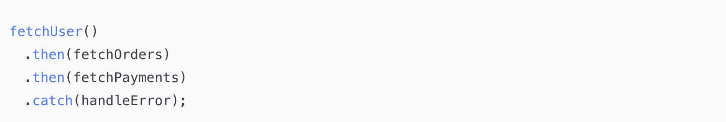
How to Consume a Promise (then, catch, finally)
Promise chaining - avoids callback hell.
Notes:
const promise = new Promise((resolve, reject) => {
const success = true;
if (success) resolve("Done");
else reject("Error happened");
});
promise
.then((res) => console.log(res))
.catch((err) => console.log(err))
.finally(() => console.log("Always runs"));

Slide 27
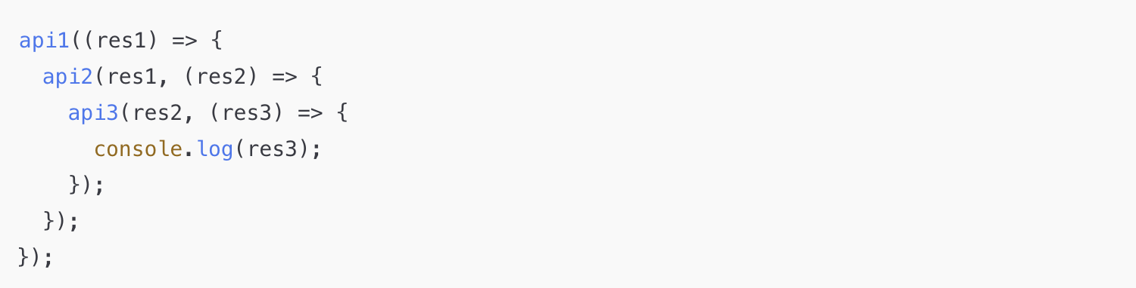
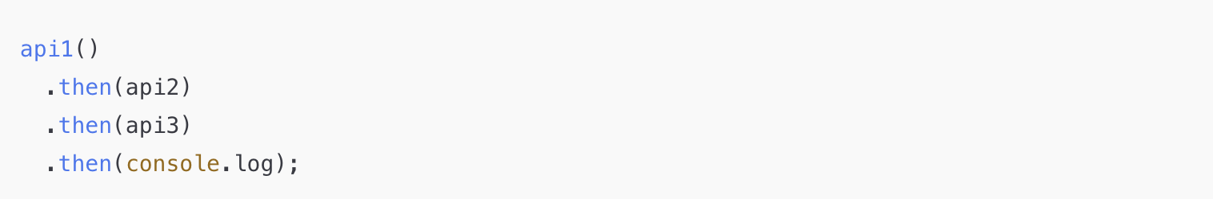
Callback Hell

Slide 28
Exercise
https://docs.google.com/document/d/1pqWPPGdME-LEfmAVdIbfXo2nPdYWgsWE2BR-A8VbCrc/edit?tab=t.0

Slide 29
Feedback

Slide 30
Thank You

